Slide 1
BUDGET 2020-21
Economic Outlook,
Fiscal Strategy And
State Recovery Plan
Hon. Ben Wyatt MLA, Treasurer of Western Australia

Slide 2
Economic Conditions And Outlook

Slide 3
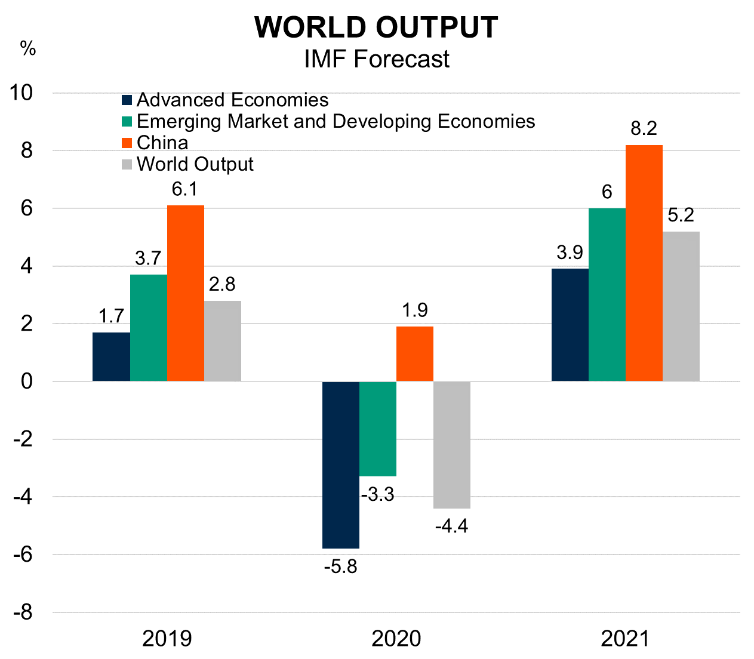
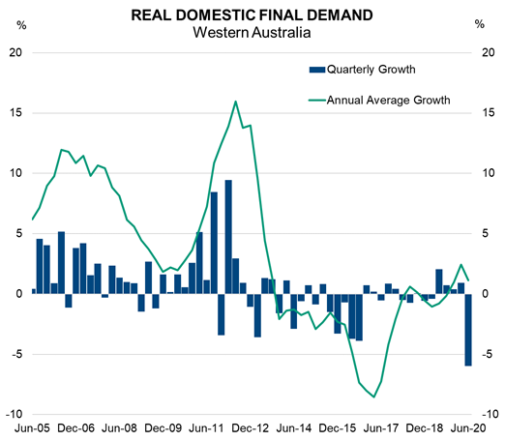
Economic Growth
COVID-19 has had devastating impacts on public health and economies globally, and halted the momentum building in the WA economy

Slide 4
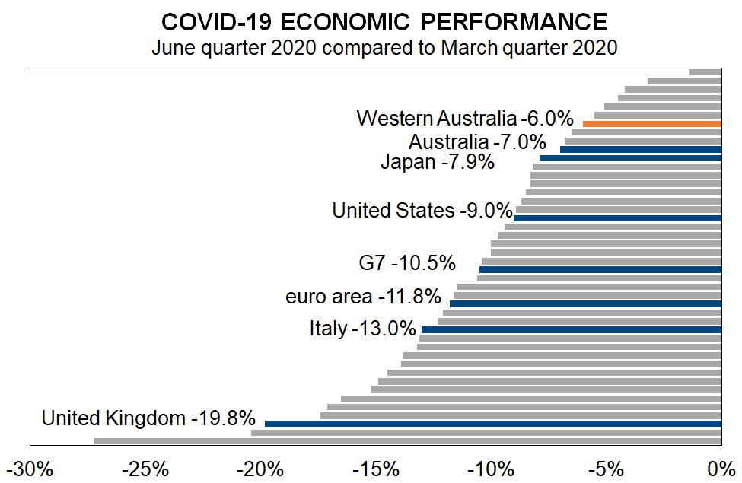
Global comparison
Evidence shows that countries most successful in stopping COVID-19 spread have also limited the economic damage

Slide 5
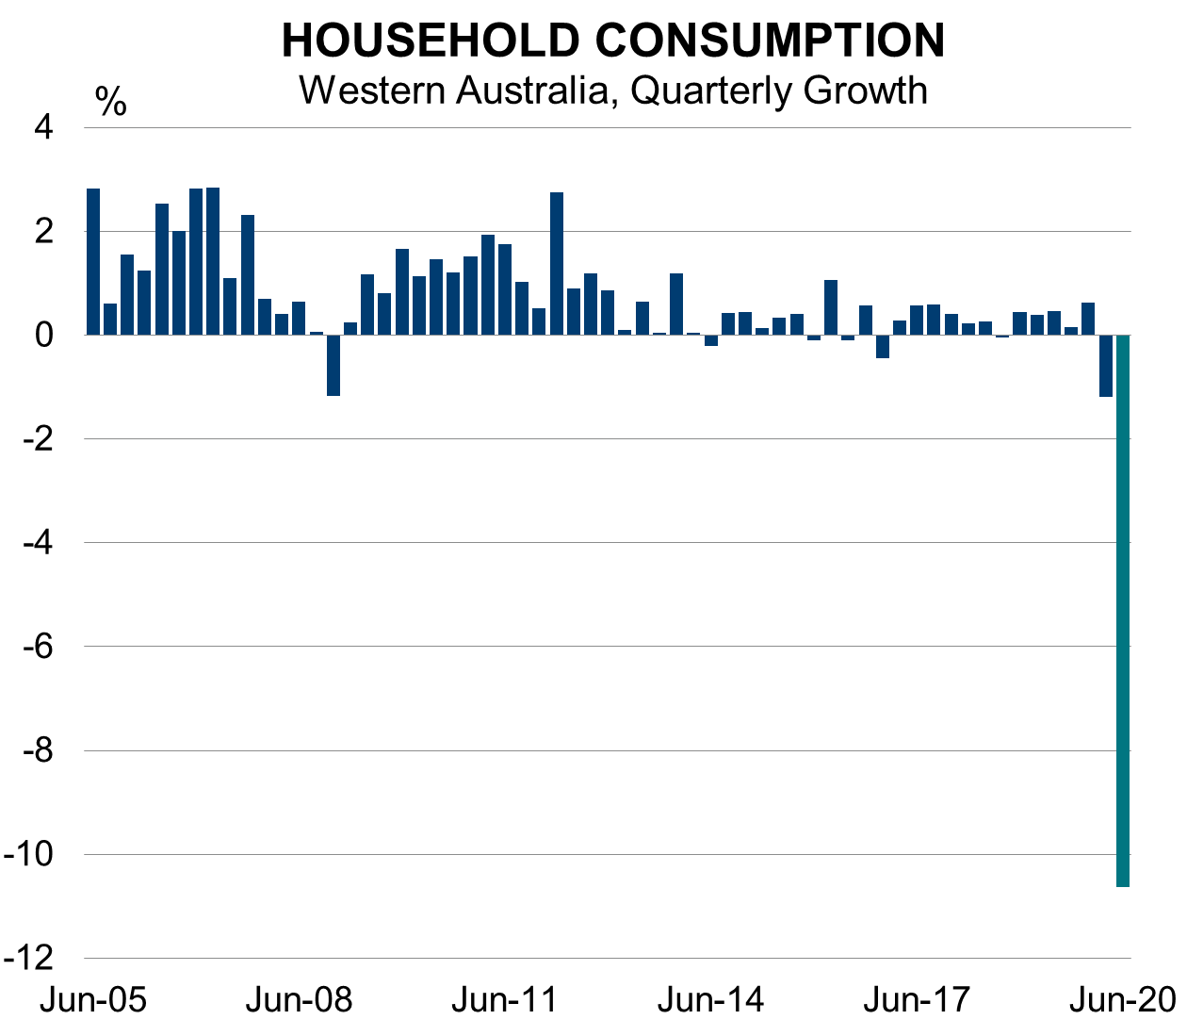
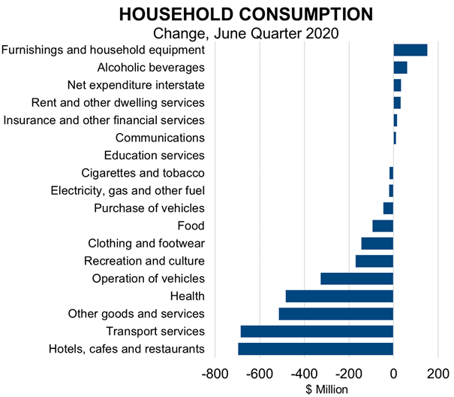
COVID-19 Impact – Households
The contraction in the June quarter was driven by a 10.6% fall in household consumption, with hospitality and transport most impacted

Slide 6
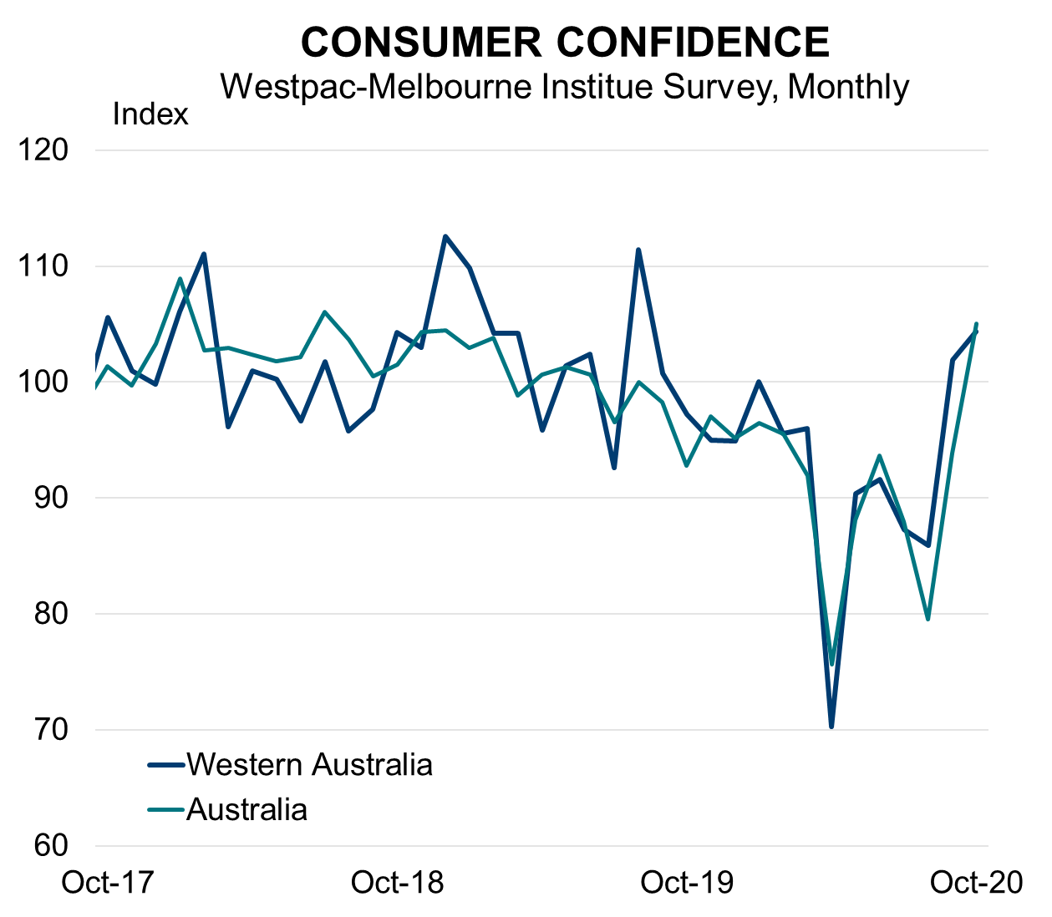
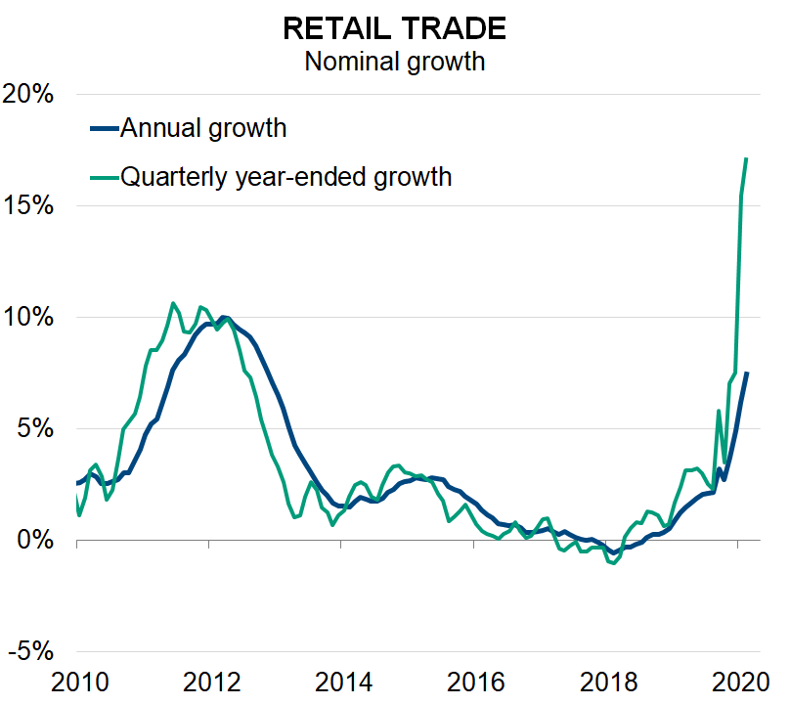
Consumer Confidence
WA has seen a sharp rebound in confidence, which has flowed through to strong growth in retail spending

Slide 7
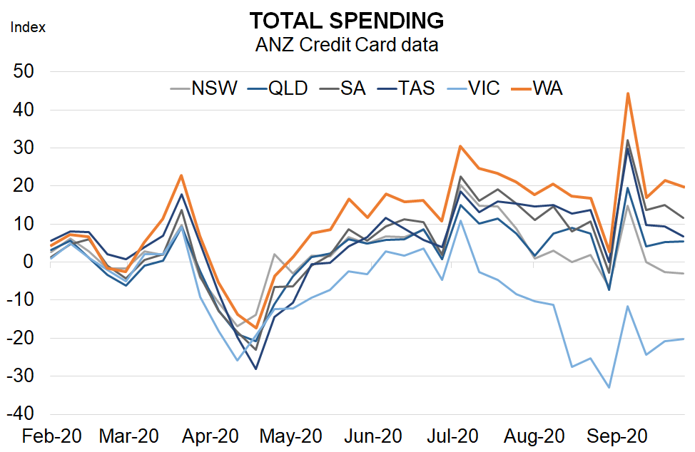
Credit card data
Credit card data highlights Western Australia’s rebound across all areas of discretionary spending has been the strongest of the States

Slide 8
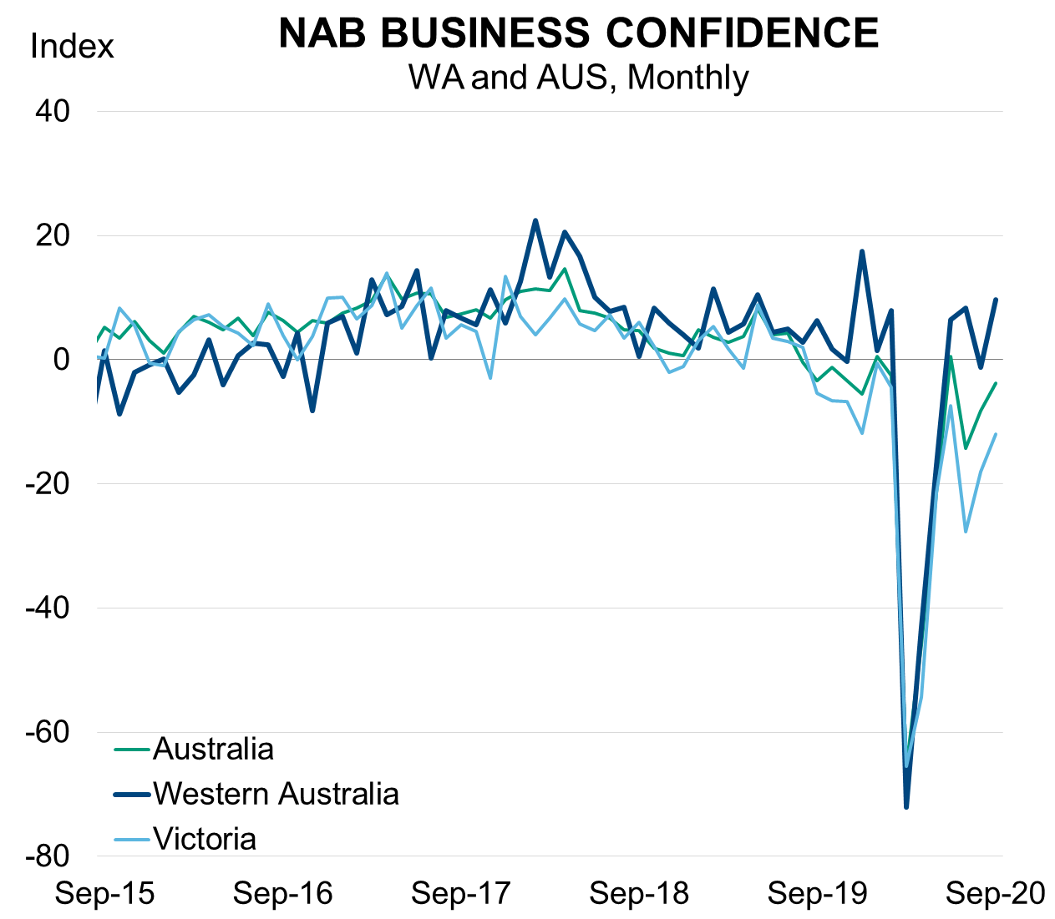
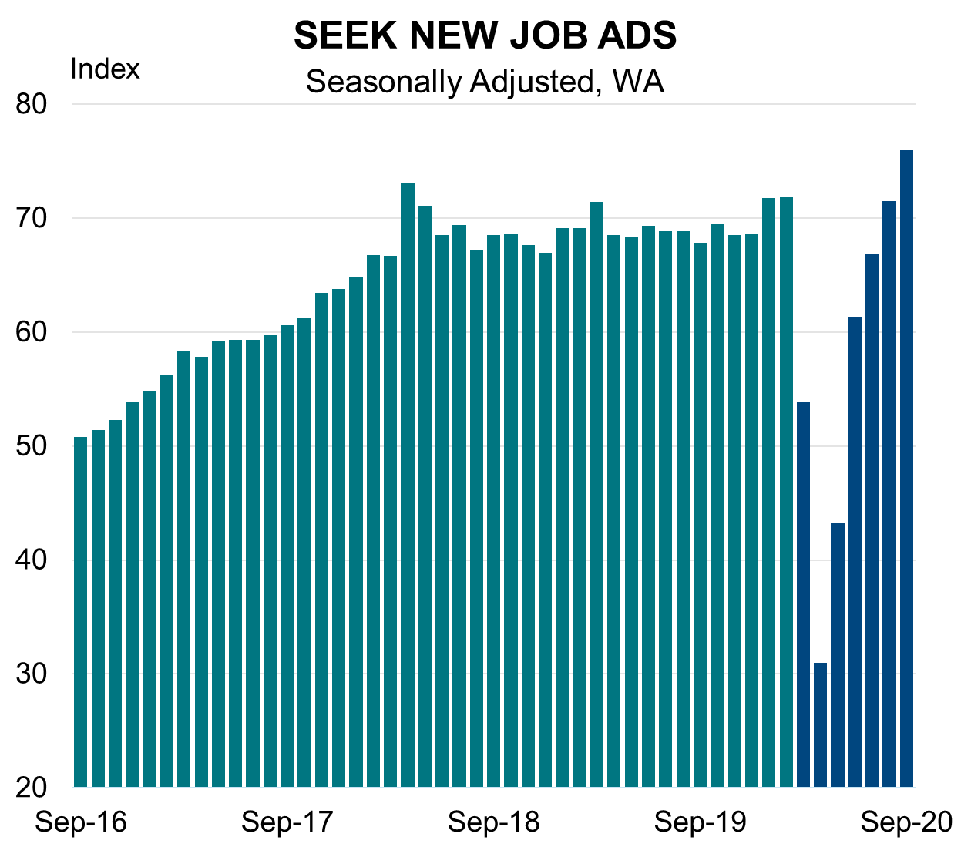
Business Confidence
Business confidence has returned to positive territory and above national levels, which is flowing through to hiring intentions

Slide 9
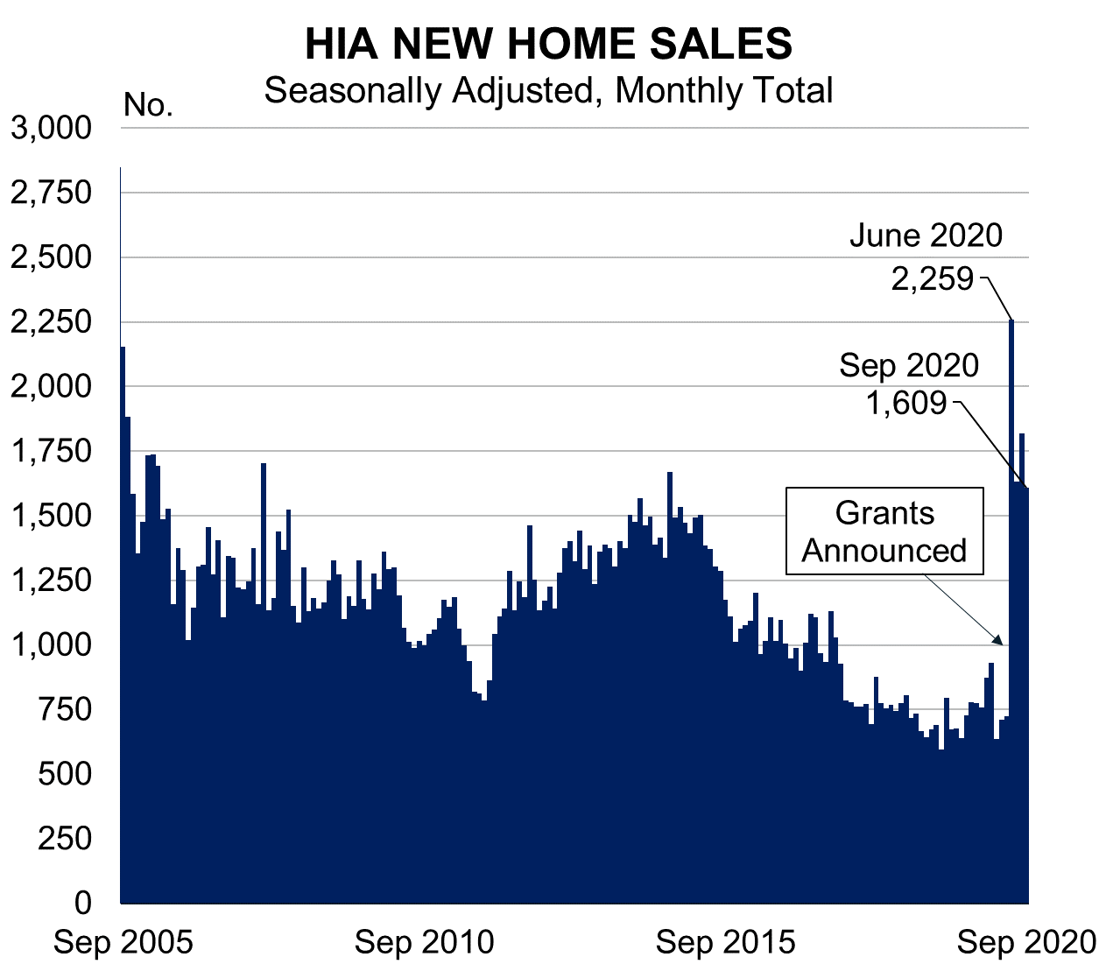
Housing Market
The Government’s housing stimulus measures have almost doubled the pipeline of works for the residential construction sector

Slide 10
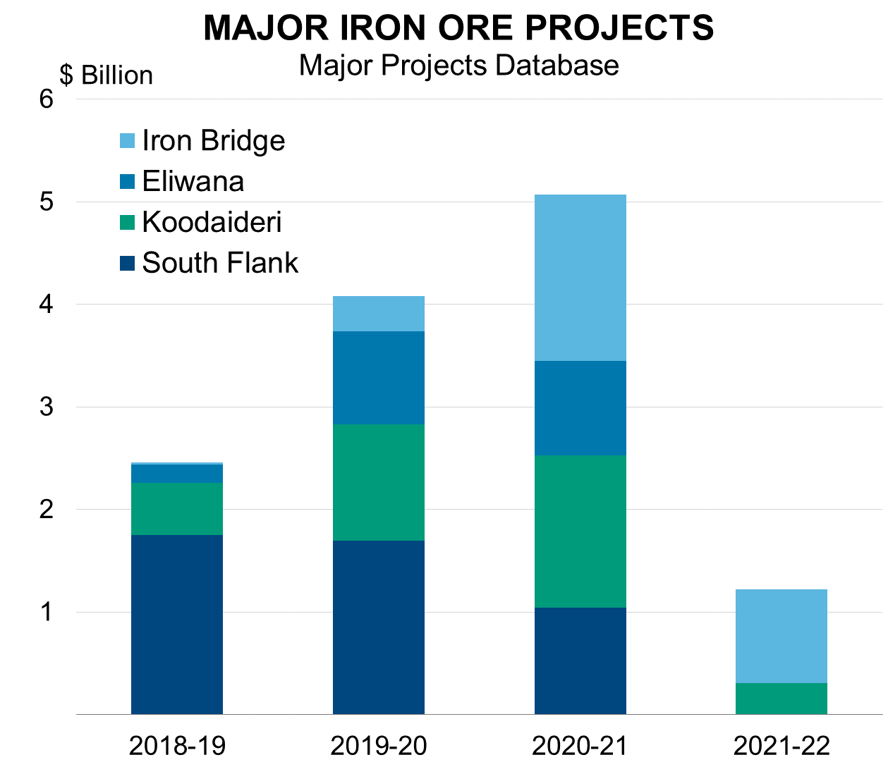
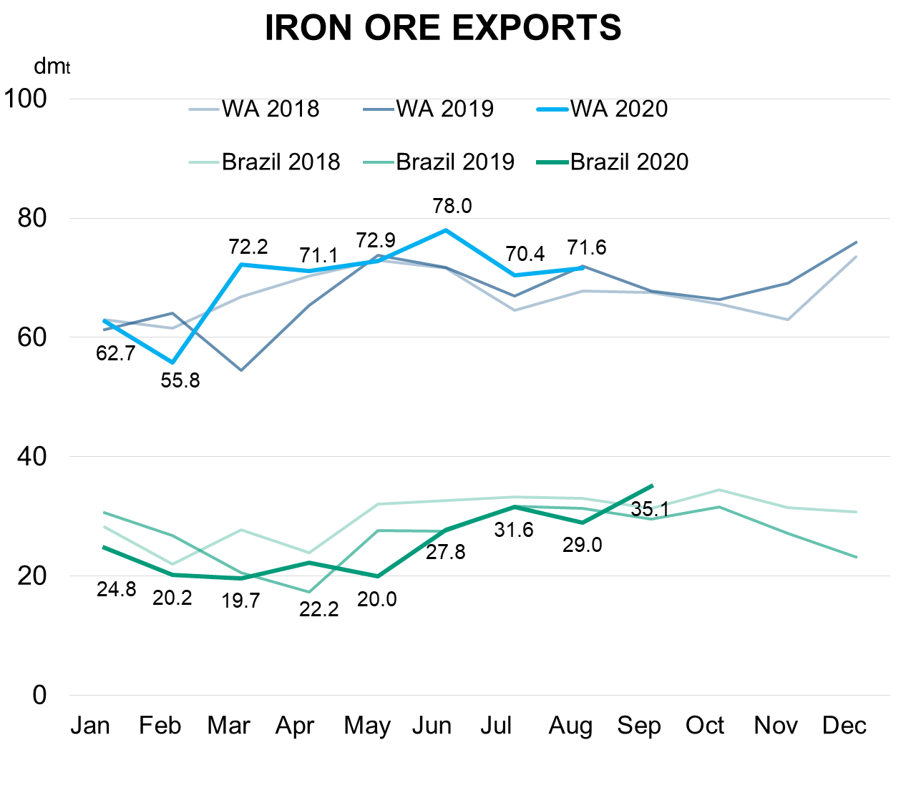
Mining Sector
The State and national economies have benefitted from the continued operation and strength of the WA mining industry

Slide 11
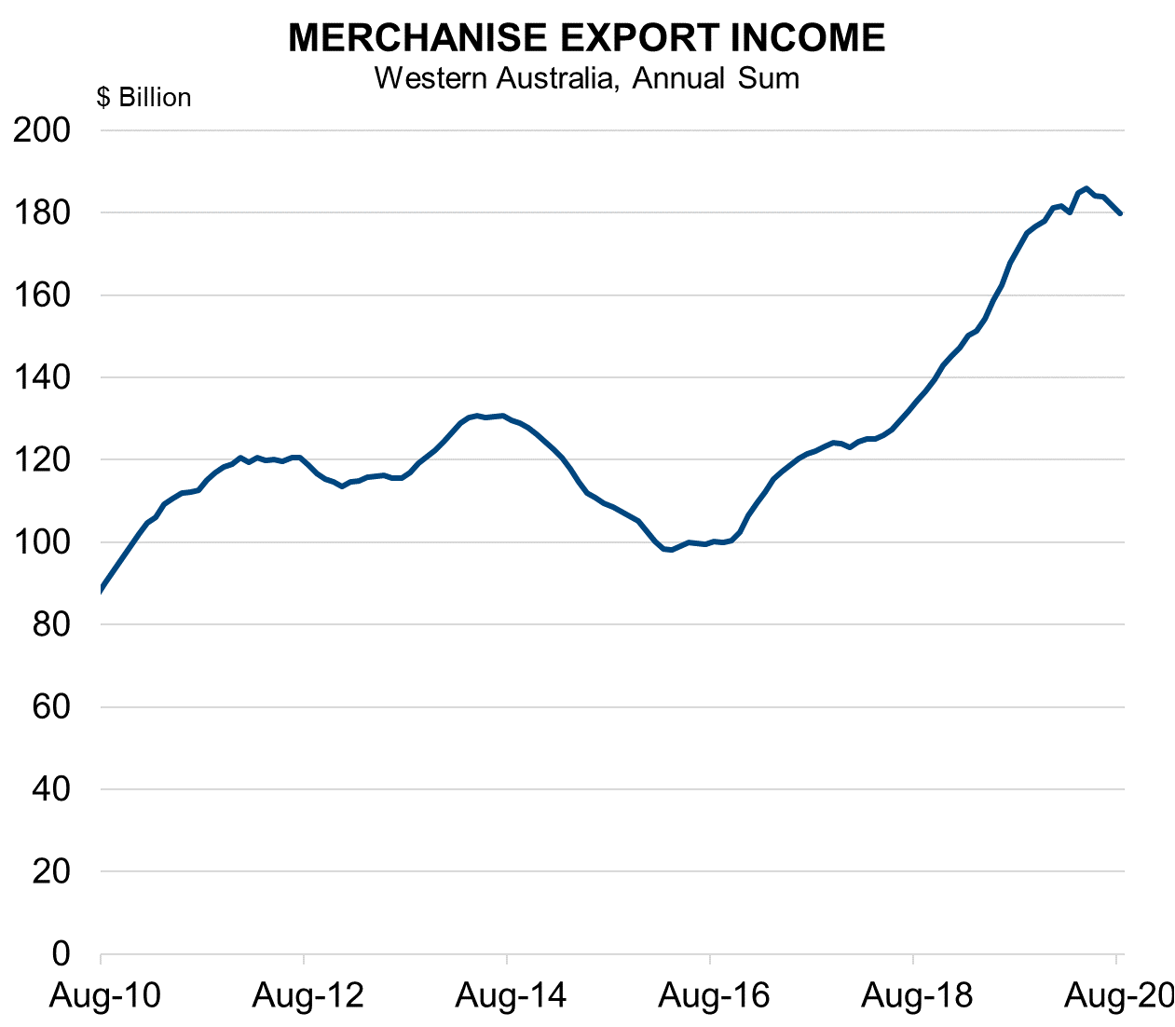
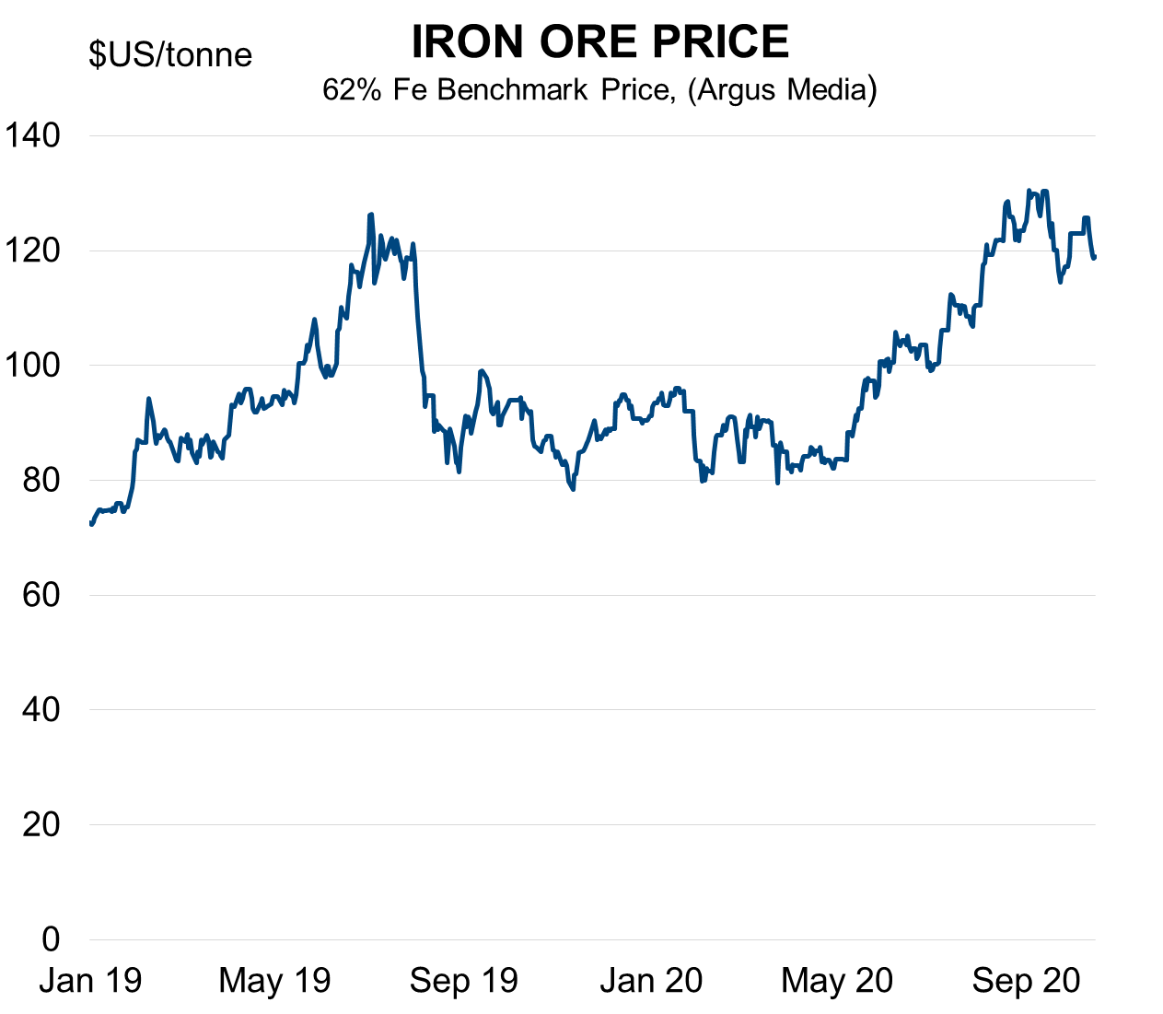
Export Income
Stronger export income has cushioned the financial impact to some extent for the State and Commonwealth

Slide 12
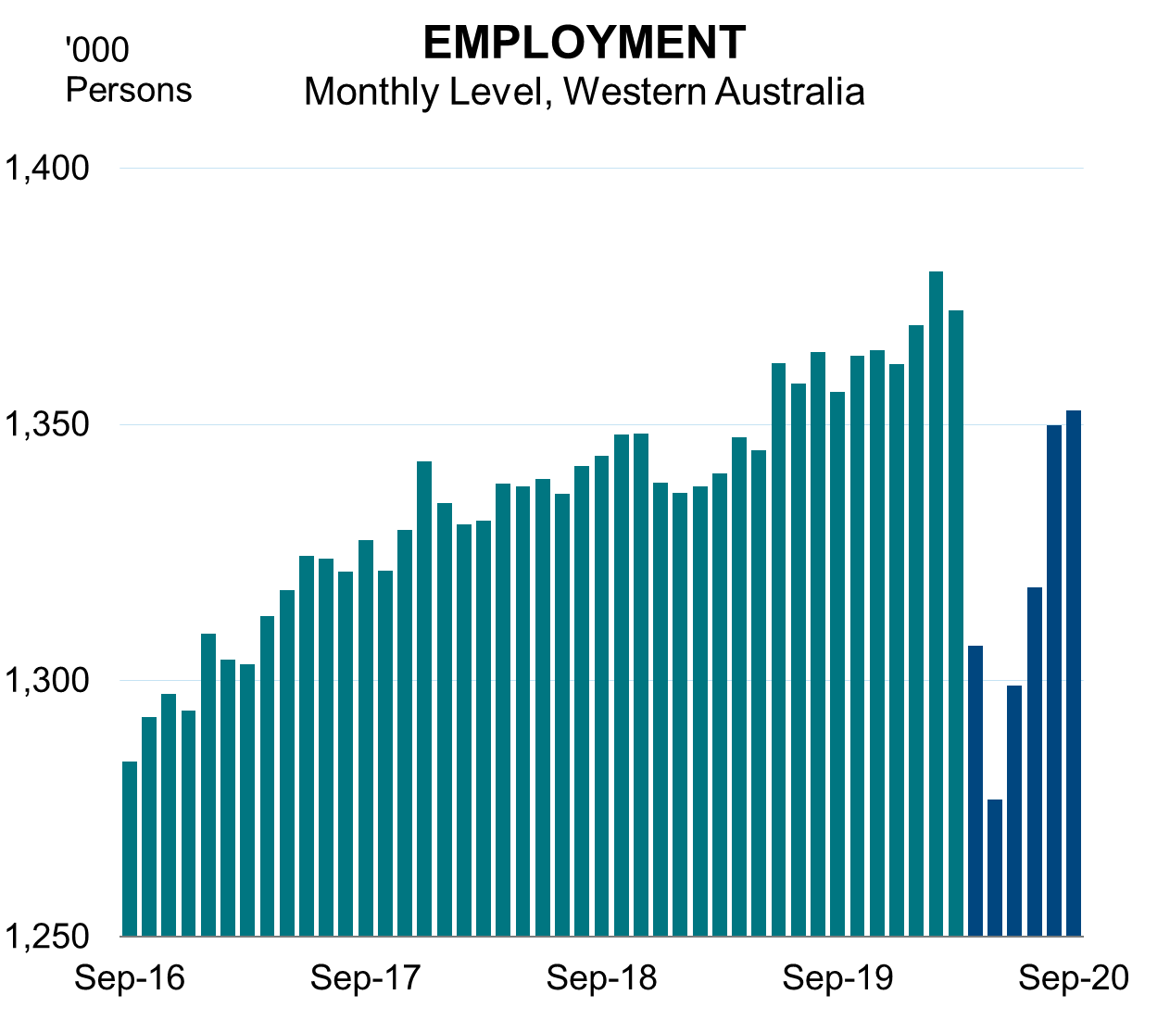
Labour Market
The Western Australian labour market has been recovering solidly, with the unemployment rate equal lowest of the States

Slide 13
Economic Forecasts
Continued economic growth is expected over the Budget period, albeit lower than forecast at Mid-year Review

Slide 14
Fiscal Strategy

Slide 15
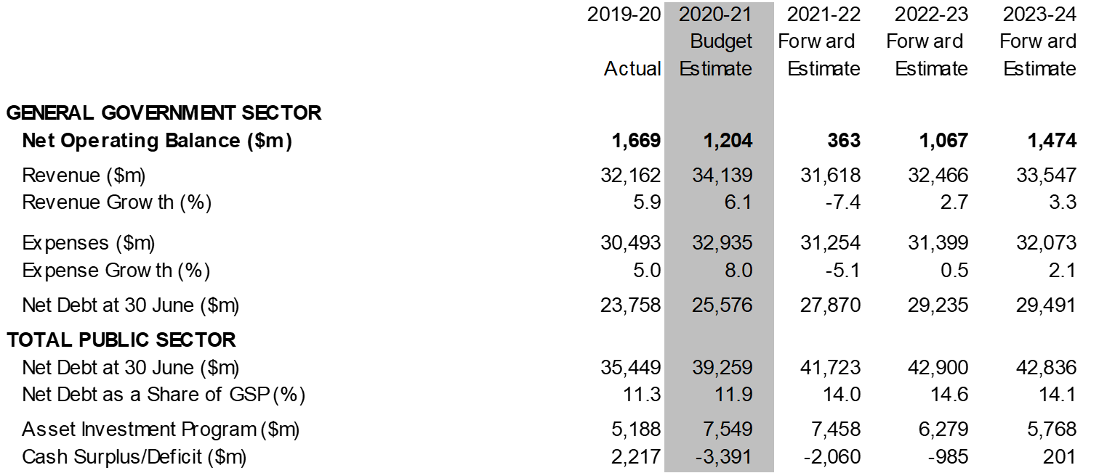
Budget Aggregates
Prior to COVID-19, Government fiscal strategy focused on budget repair, debt reduction and building capacity

Slide 16
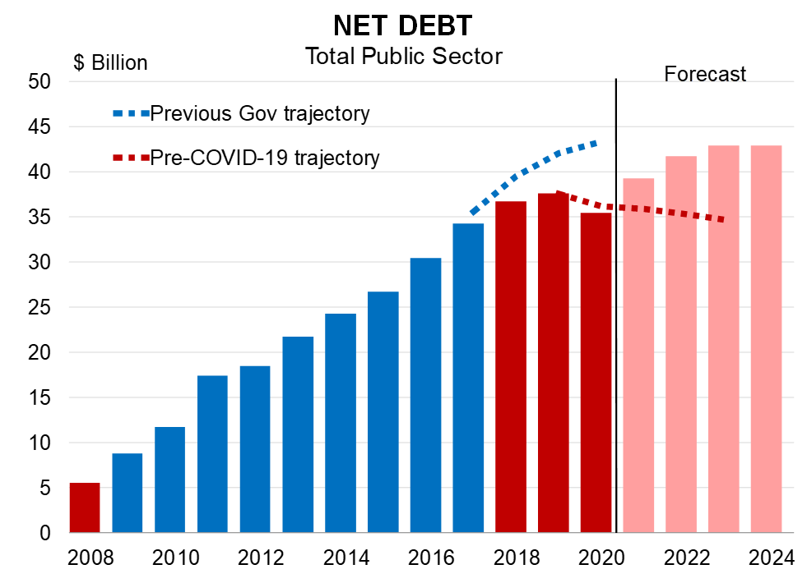
Fiscal Strategy
In response to COVID-19, the fiscal strategy has been redirected to supporting economic recovery and jobs

Slide 17
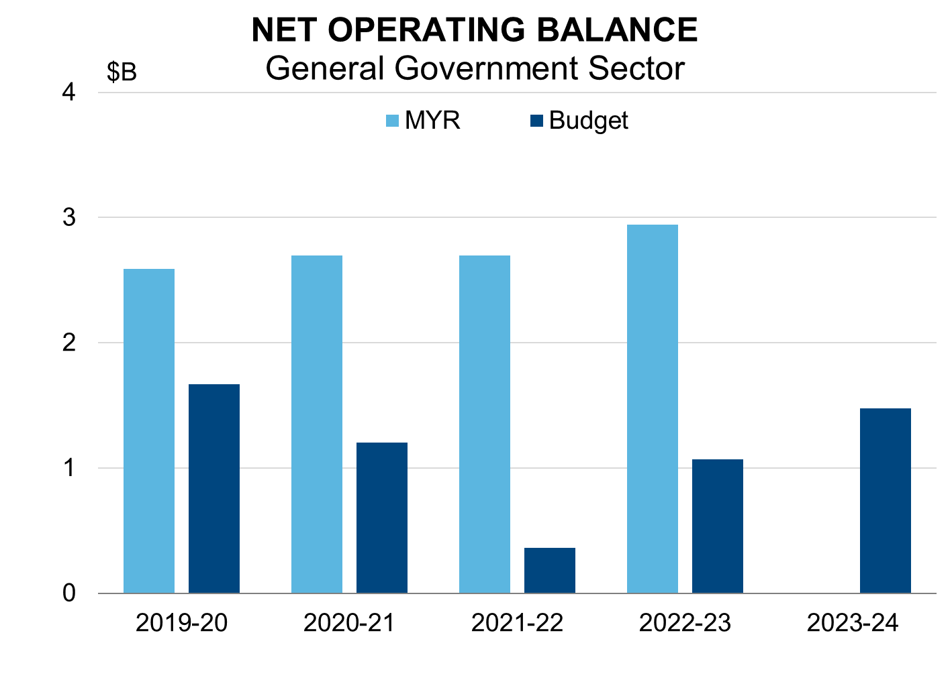
Net Operating Balance
Operating surpluses significantly reduced to respond to COVID-19, with residual funds fully allocated to job-creating infrastructure investment
Projected surpluses reduced by $6.6 billion compared to 2019-20 MYR given:
increased expenditure (up $4.9 billion) and
lower revenue (down $1.7 billion)

Slide 18
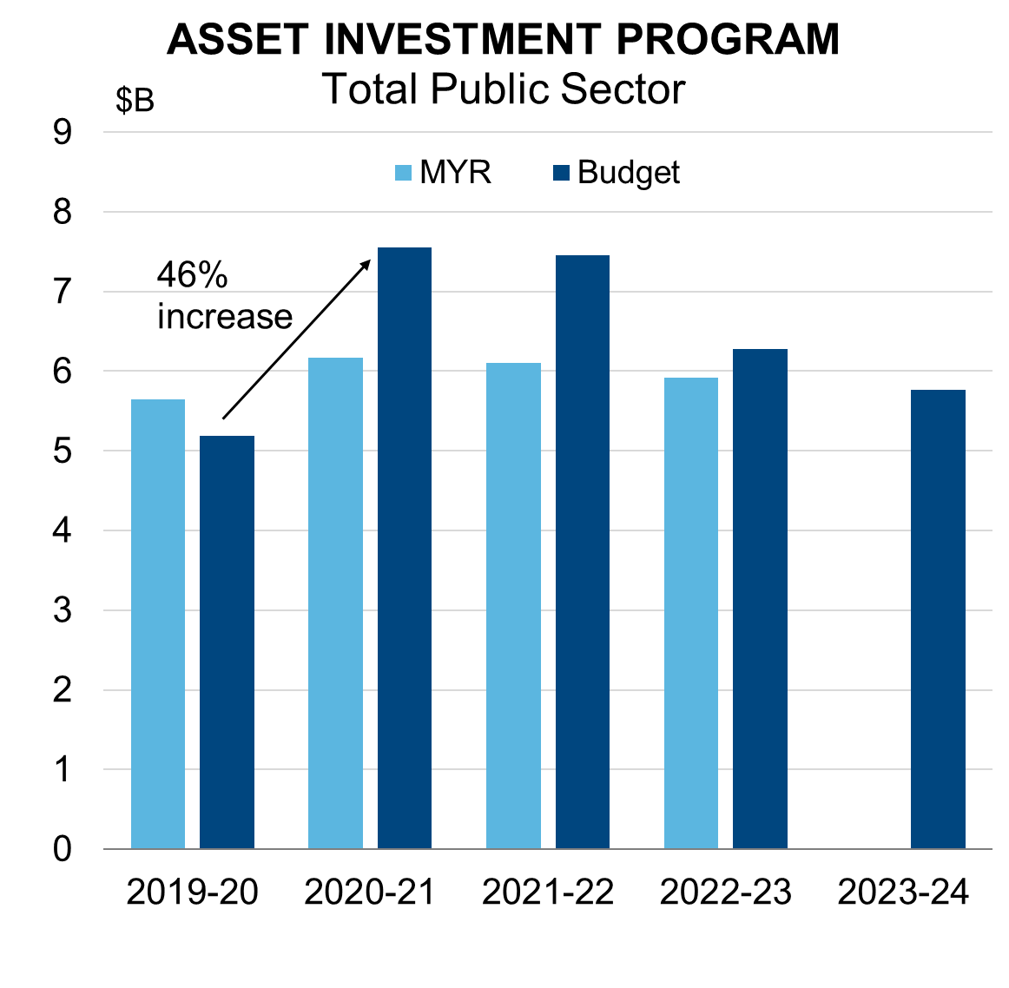
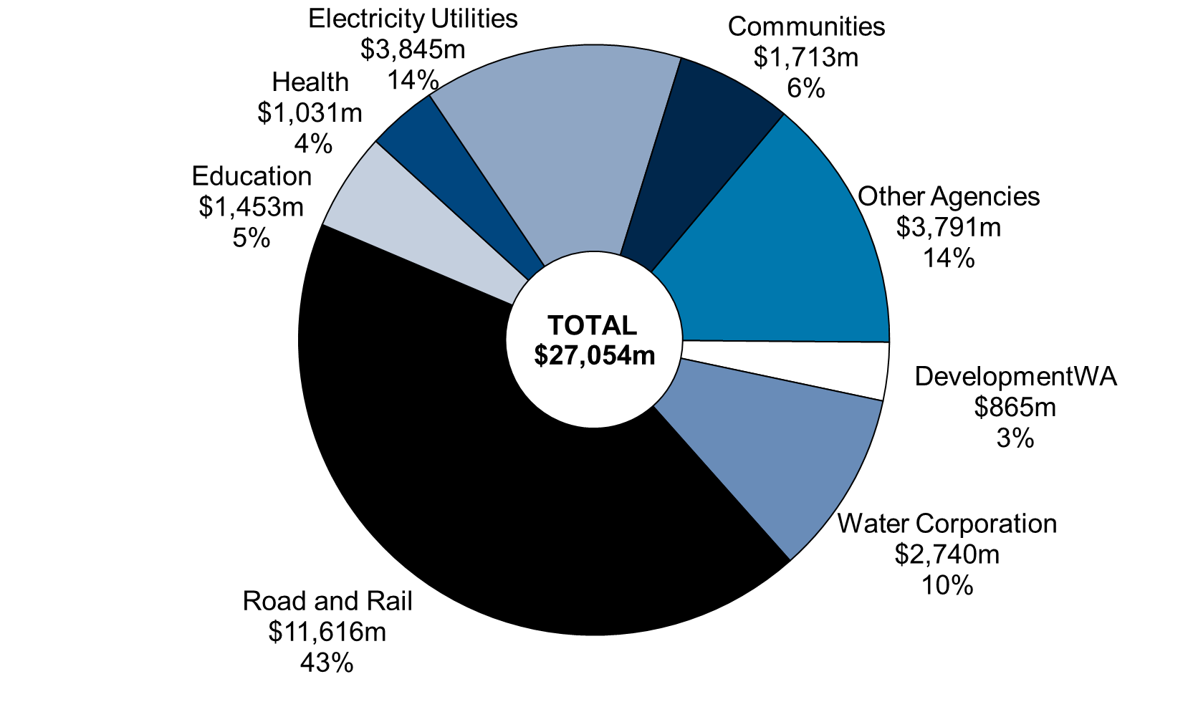
Infrastructure Investment
The Budget includes record infrastructure investment of
$27.1 billion to support economic recovery and jobs
ASSET INVESTMENT PROGRAM
2020-21 to 2023-24

Slide 19
State Recovery Plan And Budget Measures

Slide 20
WA Recovery Plan
Unprecedented $5.5B investment and comprehensive plan to drive economic and social recovery
  $2.8b in immediate support measures
    $475 million to support the housing construction sector, including building grants, and social housing investment
  $2.2b in capital works focussed on shovel-ready projects
  Wide-ranging investments to diversify our economy
  Significant $229.2 million investment in training
    $167.4m investment to upgrade TAFE infrastructure across WA
    $57m to cut TAFE fees across priority courses and free short courses to engage displaced workers

Slide 21
Significant Budget Measures
The 2020-21 Budget builds on the Recovery Plan to keep Western Australians safe and our economy strong
  $644 million for the $600 Household Electricity Credit
  $314 million for additional 800 police officers, on top of 150 in response to COVID-19
  $306 million record increase in mental health funding to over $1b per year
  $201 million Remote Aboriginal housing maintenance and services
  $170.5 million contribution to establish inner-city university campuses
METRONET progressing well with seven projects under construction
  $5.7b total investment in this Budget
  Additional projects brought forward to support recovery

Slide 22
Red tape reduction
The McGowan Government is cutting red tape to make it easier to do business and accelerate our economic recovery
  $37.2m for Environment Online and Biodiversity Information Office
  Major reforms to the State’s planning system
  $2.3m to assist local governments in simplifying approvals
  Legislative reforms to streamline processes for mining, tourism and other developments
  Reduced assessment timeframes for exploration applications
  $7m to enhance geoscientific records to unlock new mineral discoveries

Slide 23
Concluding Remarks
  Efforts of Western Australians limited community transmission and resulted in an economic impact that was far less than first anticipated
  WA Recovery Plan and measures in the Budget focus on driving the State’s economic recovery, supporting households and businesses, and boosting key services

